Slide 1
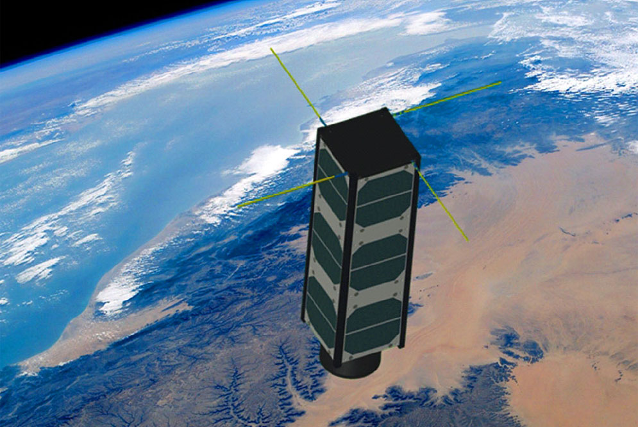
Preliminary design and performance evaluation CubeSat optical imaging payload system
Define mission objectives and requirements:
Conducting mission feasibility study:
Selecting the sensor:
Mechanical design concept:
Optical and telescope design:
Electronics and control system:
Performance evaluation
The mission objectives and the specific requirements of the optical imaging system suppose to be clearly defined considering the factors such as spatial resolution, spectral bands, FOV, data storage capacity, power consumption, mass and volume constraints.
Assess the feasibility of the mission and suitability of the CubeSat platforms for achieving the mission goals.
Select optical imaging sensor that aligns with the mission requirements considering factors such as sensor type, resolution, and spectral sensitivity.
Preliminary design of optical system including telescope or lens assembly considering parameters like focal length, aperture size, FOV and conduct basic optical simulations to assess system performance
Preliminary design of electronic and control components including power management, imaging acquisition, data storage and on-board processing.
Preliminary design mechanical structure of imaging payload system with 3U CubeSat form factor and weight constraints considering structural stability, thermal management and alignment of optical components.
Preliminary performance evaluations, including optical simulations and analysis, to assess imaging payload capabilities and alignment with mission requirements

Slide 2
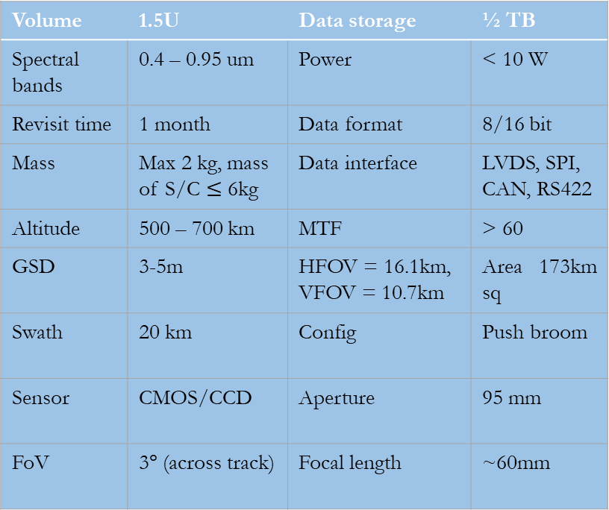
Define mission objectives and requirements:
Advancement of CubeSat-based technologies including EO are revolutionizing the way we monitor environmental from form space.
CubeSat can be used for variety of space based environmental monitoring tasks such as:
Measuring the amount of pollutant in the air and ocean temperature.
Measuring variation in plant life and land cover.
Monitoring natural disasters such as wildfires, floods and hurricanes.
The primary mission objective of 3U CubeSat:
To detect, identify and monitor wildfires through out south Korea including Gangneung (eastern coastal city) and Uljin county (seaside area in north Gyeongsang province).
The secondary mission objectives are:
To collect statistical data on the outbreak and growth of wildfires.
To monitor forest fires for other foreign countries.
To collect other forest management data and to demonstrate the public proactive action.
Preliminary requirement definition
Volume | 1.5U | Data storage | ½ TB
Spectral bands | 0.4 – 0.95 um | Power | < 10 W
Revisit time | 1 month | Data format | 8/16 bit
Mass | Max 2 kg, mass of S/C $≤$ 6kg | Data interface | LVDS, SPI, CAN, RS422
Altitude | 500 – 700 km | MTF | > 60
GSD | 3-5m | HFOV = 16.1km, VFOV = 10.7km | Area 173km sq
Swath | 20 km | Config | Push broom
Sensor | CMOS/CCD | Aperture | 95 mm
FoV | 3$°$ (across track) | Focal length | ~60mm
Notes:
Source:
https://www.reuters.com/business/environment/south-korea-city-wildfire-fanned-by-strong-winds-evacuations-begin-2023-04-11/
https://disasterphilanthropy.org/disasters/south-korean-wildfires/

Slide 3
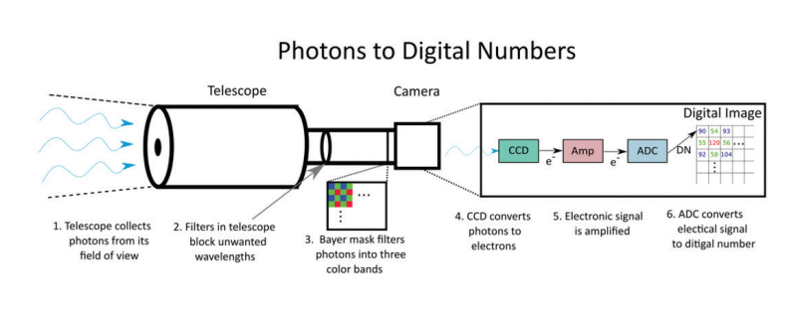
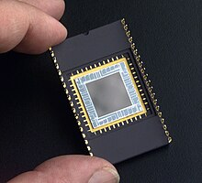
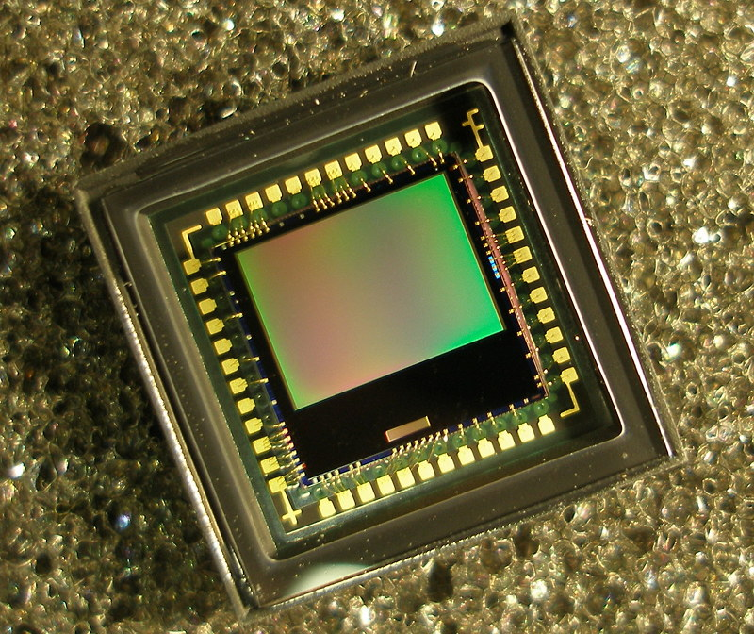
Selecting image sensor
An image sensor is a sensor that detects and conveys information used to form an image
It can be used in electronic imaging devices of both analog and digital including digital camera, camera modules, medical imaging equipment, thermal imaging devices, radar and other.
Typically there two types of electronic imaging sensor: CCD and CMOS.
In this project on of the sensor is utilized from COTs depend on the mission of the spacecraft.
Figure 1: Schematic view of optical system and camera (Credit: Planet Lab)
Both sensor accomplish the same task of capturing of light and converting into electrical signals.
However, CMOS is usually cheaper and consume less power as compared CCD sensor.
Figure 2: Typical CCD and CMOS sensor (credit: Teledyne e2v)
Notes:
Optical aberrations are the deviations from the geometric optics that are mainly caused by faults in optical lenses. The main types of aberrations are spherical, comatic , distortion, astigmatism, field curvature and chromatic aberration.
Comatic aberration is caused by off-axis light fluxes and is regarded as the worst among aberrations due to the symmetry of the image that it causes.

Slide 4
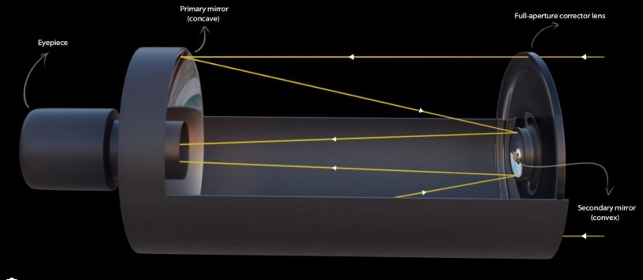
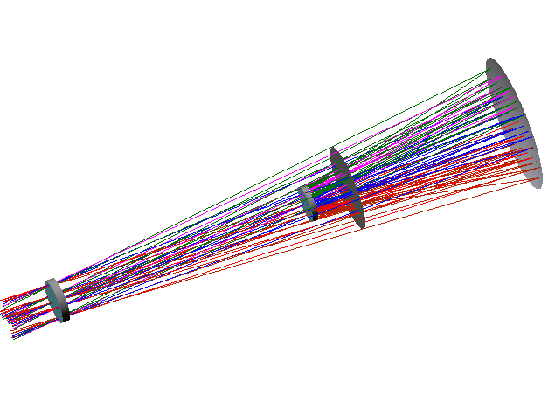
Optical and telescope design: Tradeoff
1. Preliminary design of Flat-field Schmidt catadioptric optical system and its analysis
The Schmidt Cassegrain is a catadioptric telescope that combines a Cassegrain reflector’s optical path with Schmidt corrector plate to make compact optical system.
The preliminary performance analysis of this telescope, including MTF, spot diagram, ray aberration plot, pupil map, and others, is shown on the following pages:
Figure 3: Flat-field Schmidt catadioptric optical system
Figure 4: Flat-field Schmidt optical system 3D
Notes:
Optical aberrations are the deviations from the geometric optics that are mainly caused by faults in optical lenses. The main types of aberrations are spherical, comatic , distortion, astigmatism, field curvature and chromatic aberration.
Comatic aberration is caused by off-axis light fluxes and is regarded as the worst among aberrations due to the symmetry of the image that it causes.

Slide 5
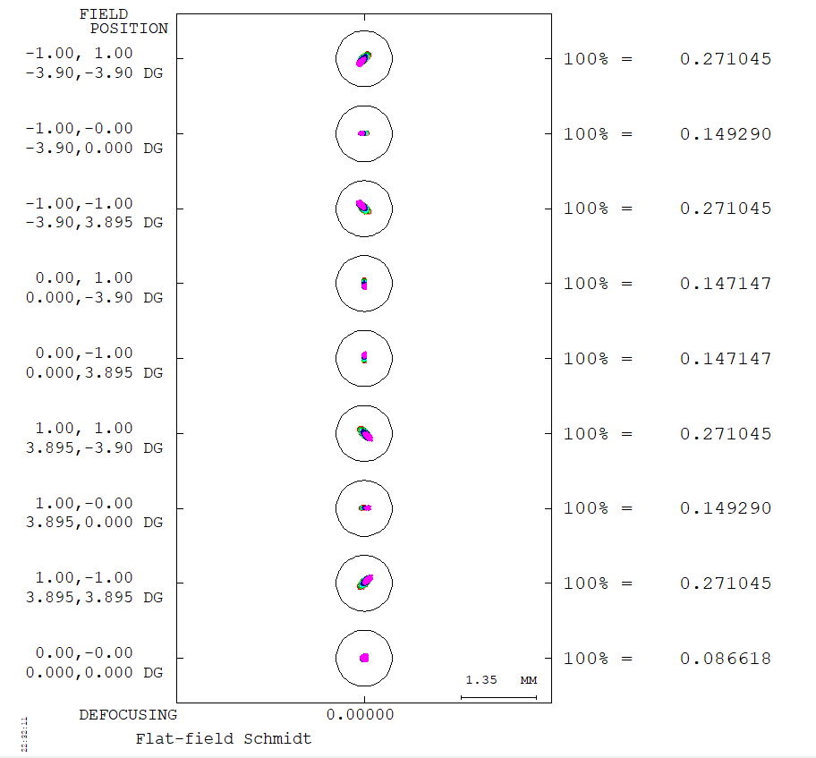
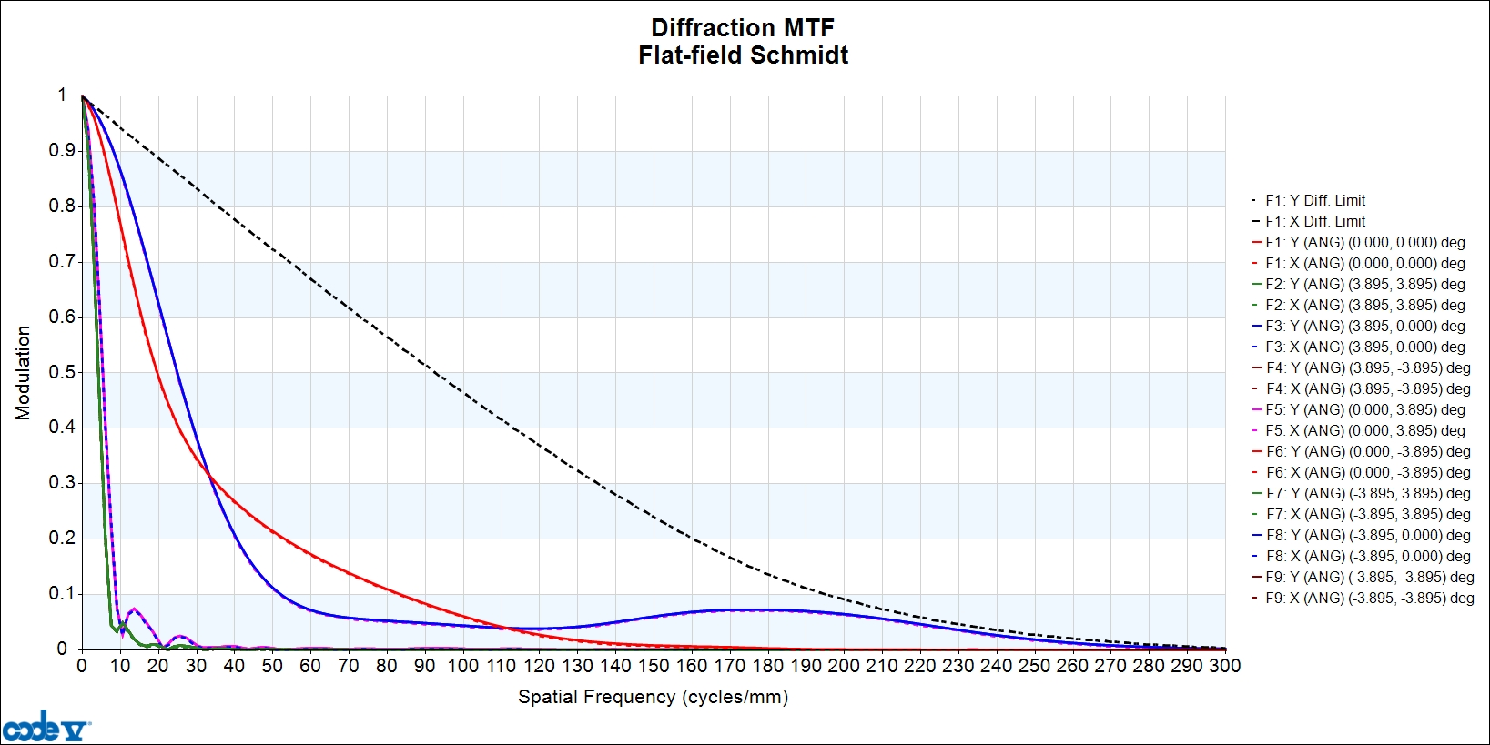
Cont’d…
MTF (Modulation transfer function): is measure of the ability of an optical system to transfer various levels of detail from object to image.
Spot diagram: are graphical tool used to show where rays from a point object will fall on the image surface (they must fall close together if the lens is to form a good image).
Figure 5: Flat-field catadioptric optical system spot diagram and its modulation transfer function

Slide 6
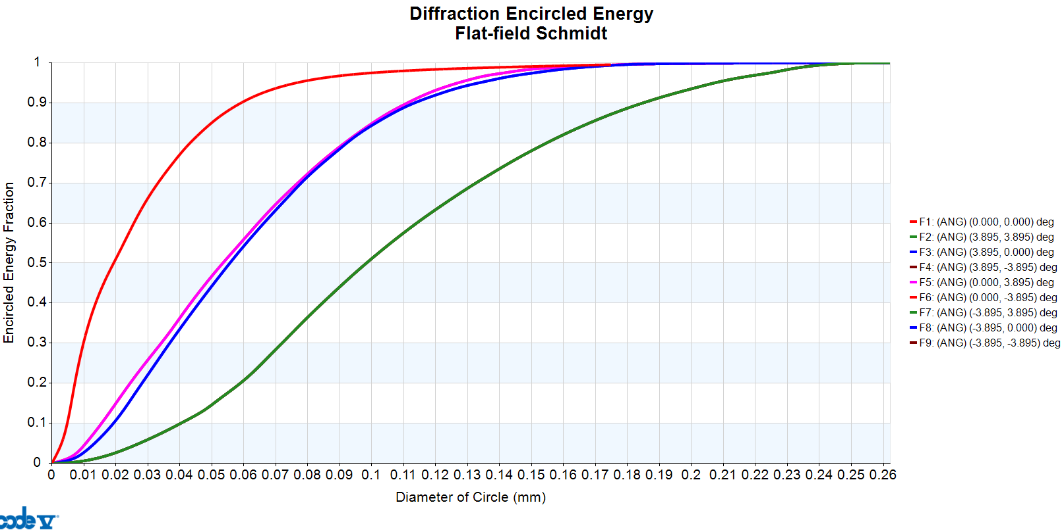
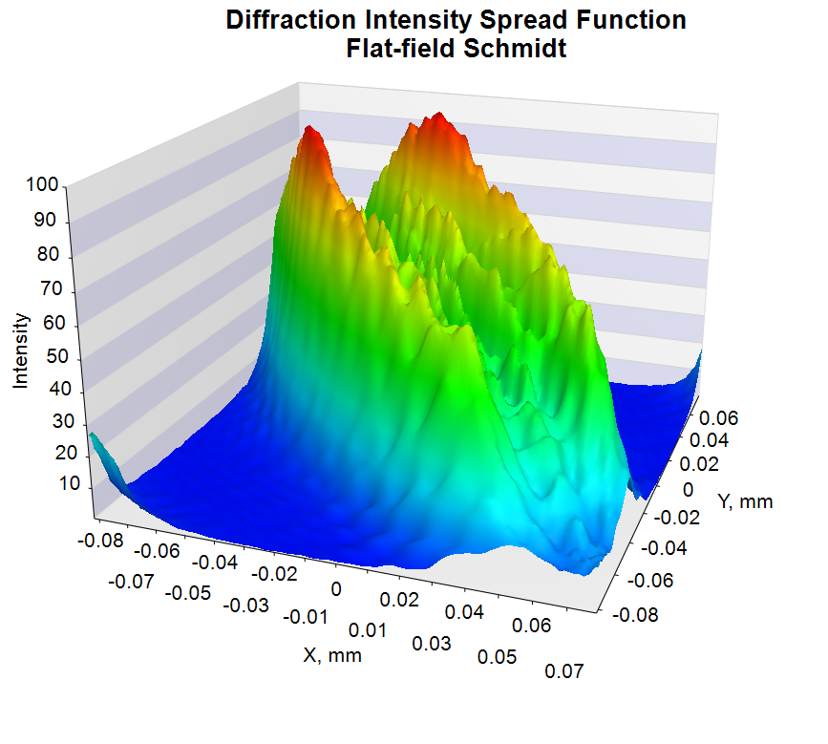
Cont’d…
Diffraction intensity spread function: computes the wave aberration of the system, and by fast Fourier transform, the diffraction image shape in the designated focal plane over the wavelength according to the weights assigned to system is the LDM.
This image patch is represented by intensity values in a grid across the image with the chief ray or optical axis as the center point of the grid.
Diffraction encircled energy: is an alternate grid display circle diameters that enclose fixed percentage of energy. The circles are minimized by scanning their centers along the y-axis running from the chief ray in the image.
Figure 6: Flat-field catadioptric optical system encircled energy fraction and its intensity spread function

Slide 7
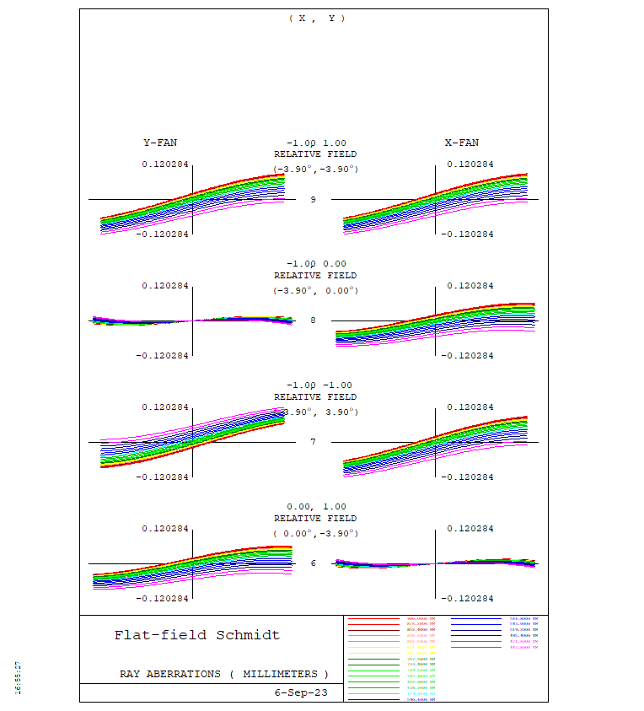
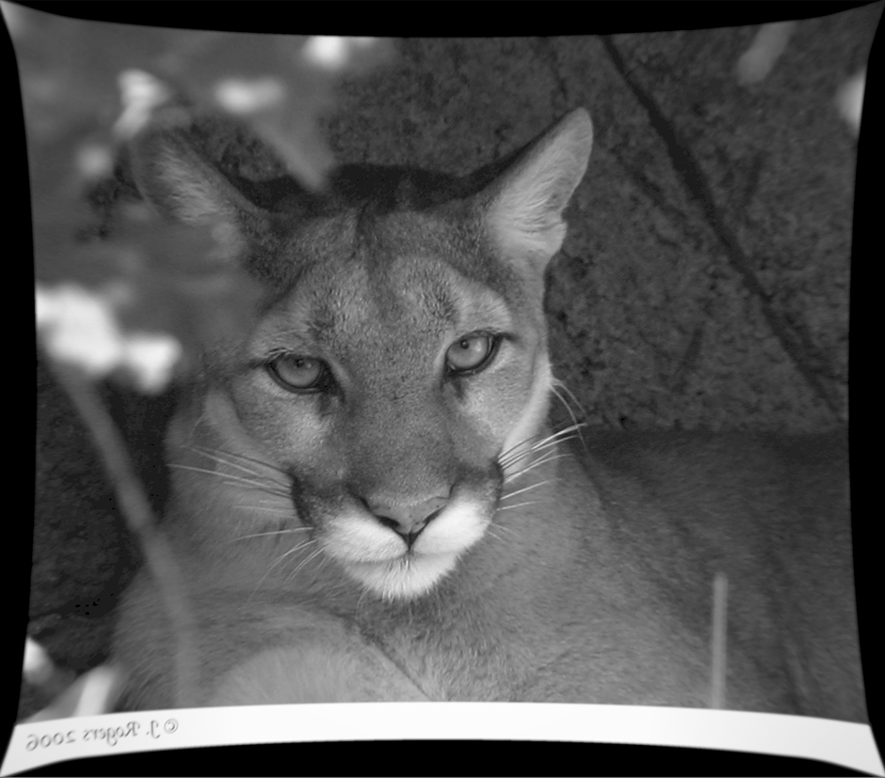
Cont’d…
Ray aberration curve: provide a graphic display of lens aberrations. It can display transverse aberration (real-ray position from real chief-ray position on image surface vertex tangent plane in lens unit) and wave aberration (optical path difference in waves at each wave length).
2D image simulation: simulates the appearance of a 2D input object as it is imaged through the optical system defined in CODE V.
Figure 7: Flat-field catadioptric optical system ray aberration plot and its 2D image simulation

Slide 8
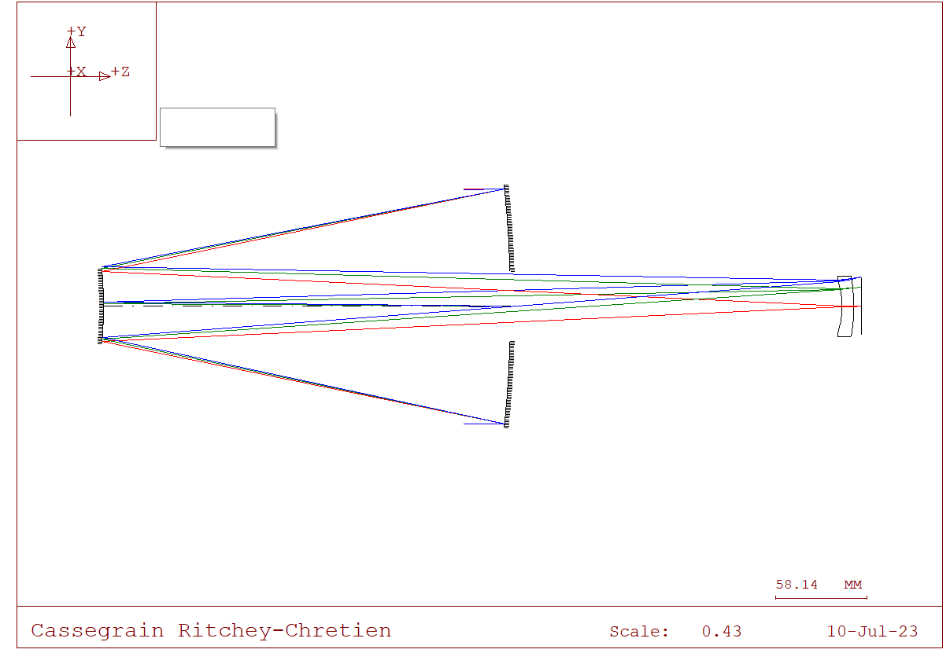
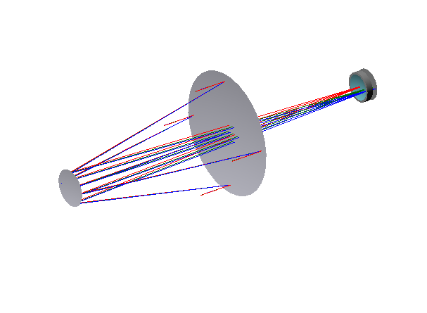



Optical and telescope design: Tradeoff
2. Preliminary design of Ritchey-Chretian optical system and its analysis
The Ritchey-Chretian telescope is a customized version of the Cassegrain telescope with a hyperbolic primary mirror and a hyperbolic secondary mirror intended to remove coma-causing off-axis optical aberrations.
This system has very short optical tube assembly and compact design for a given focal length.
It offers good off-axis optical performance, but its mirror requires sophisticated techniques to manufacture and test.
The semi-field of view and f-number for RCT are 11.680700 and ${0.6}^{0}$, respectively.
$$M_{2}$$
$$M_{1}$$
a
b
Figure 8: (a) Cassegrain Ritchey Chretien optical system and (b) its 3D viewing
Notes:
Optical aberrations are the deviations from the geometric optics that are mainly caused by faults in optical lenses. The main types of aberrations are spherical, comatic , distortion, astigmatism, field curvature and chromatic aberration.
Comatic aberration is caused by off-axis light fluxes and is regarded as the worst among aberrations due to the symmetry of the image that it causes.

Slide 9
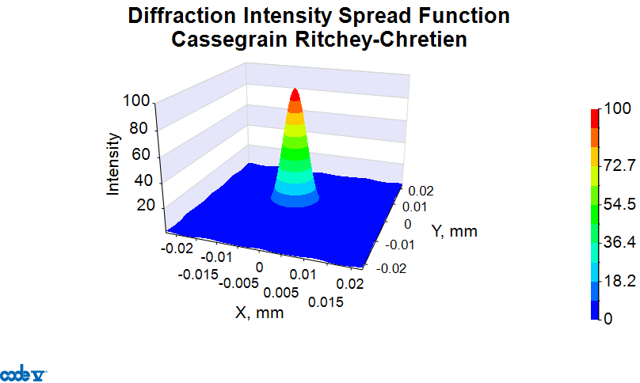
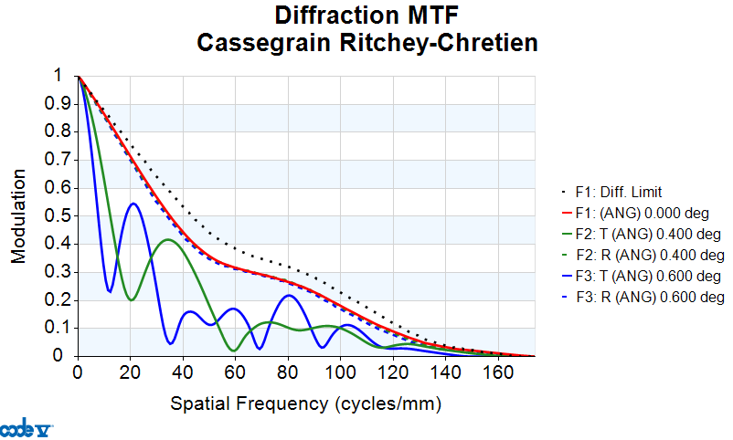
Cont’d…
The Ritchey-Chretian telescope is a customized version of the Cassegrain telescope with a hyperbolic primary mirror and a hyperbolic secondary mirror intended to remove coma-causing off-axis optical aberrations.
This system has very short optical tube assembly and compact design for a given focal length.
It offers good off-axis optical performance, but its mirror requires sophisticated techniques to manufacture and test.
a
b
Figure 9: (a) Cassegrain Ritchey Chretien optical system diffraction intensity function and (b) its modulation transfer function (MTF)

Slide 10
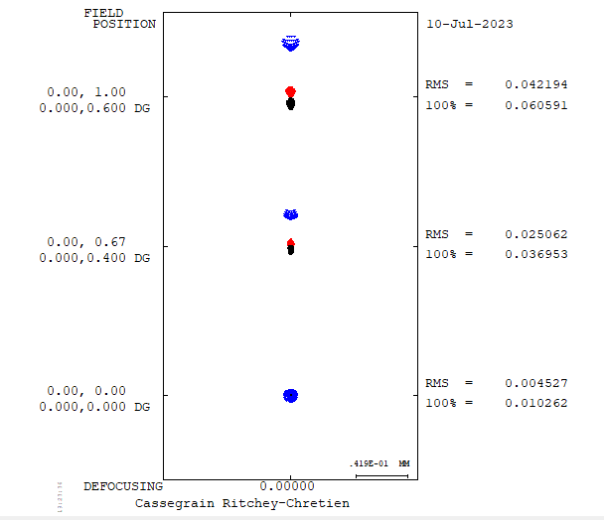
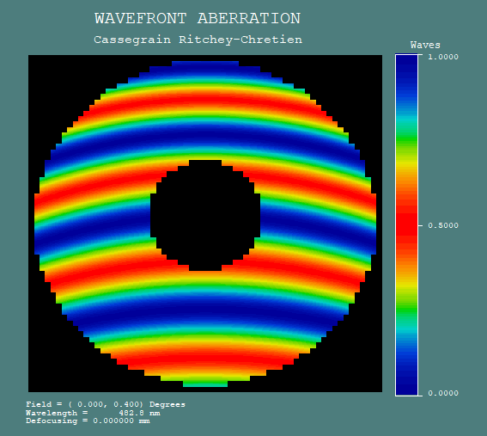
Cont’d…
Figure 10: Cassegrain Ritchey Chretien optical system spot diagram and its wave front aberration

Slide 11
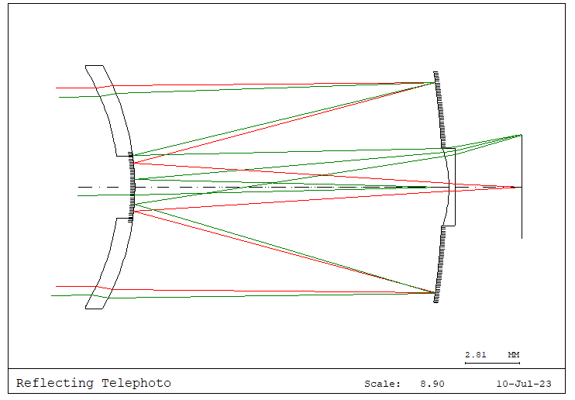
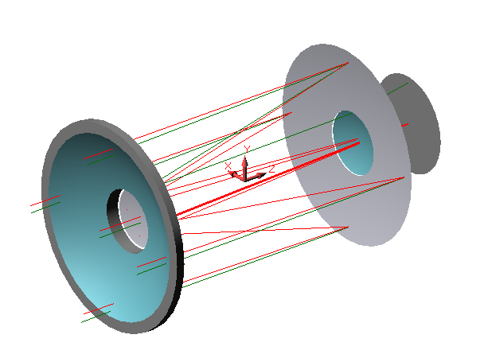

Optical and telescope design: Tradeoff
3. Preliminary design of Catadioptric optical system and its analysis
The catadioptric combine the optical benefits of both lenses and mirrors into compact package, being smaller than either reflector or reflectors of the same aperture.
This is made possibly by corrector plate that folds the light path and curved secondary mirror that magnifies the light internally as depicted in Figure 2.
The semi-field of view and f-number for catadioptric telephoto lens are 10.000 and ${1.5}^{0}$, respectively.
a
b
Figure 11: (a) Catadioptric optical system and (b) its 3D viewing

Slide 12
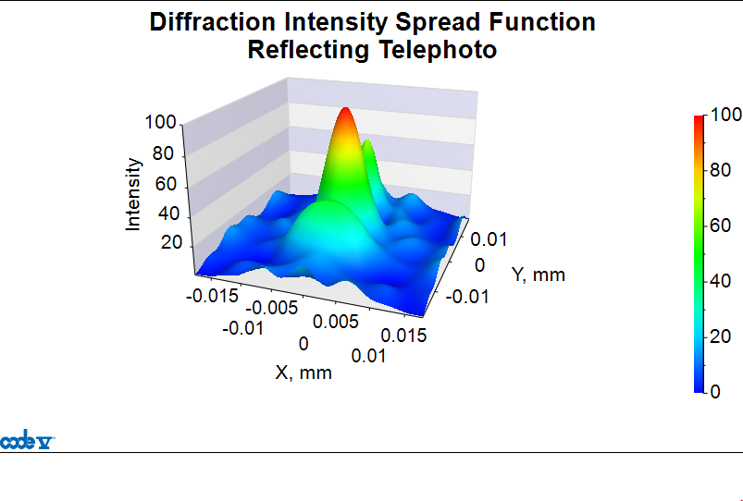
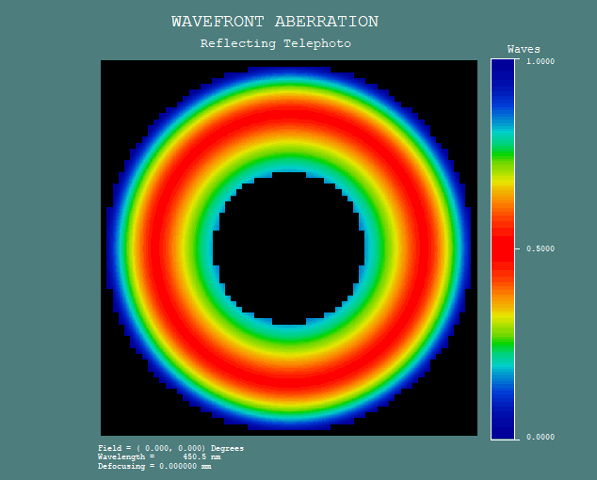
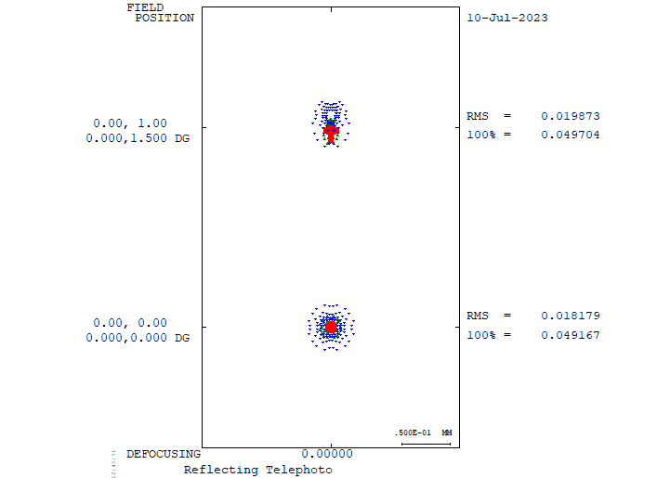
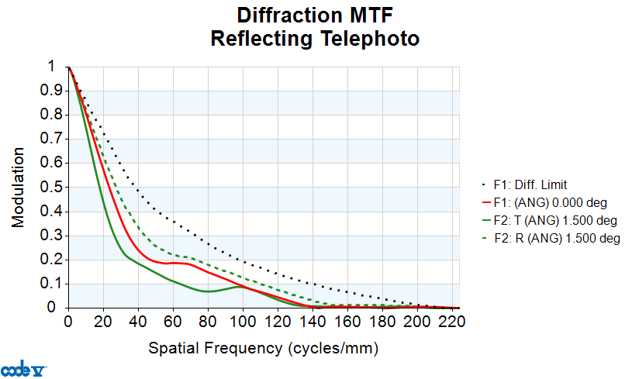

Cont’d…
The catadioptric combine the optical benefits of both lenses and mirrors into compact package, being smaller than either reflector or reflectors of the same aperture.
This is made possibly by corrector plate that folds the light path and curved secondary mirror that magnifies the light internally as depicted in Figure 12.
The semi-field of view and f-number for RCT are 10.000 and ${1.5}^{0}$, respectively.
a
b
c
d
Figure 12: (a) Catadioptric optical system diffraction intensity spread function and (b) wave front aberration, (c) Spot diagram and (d) its modulation transfer function

Slide 13
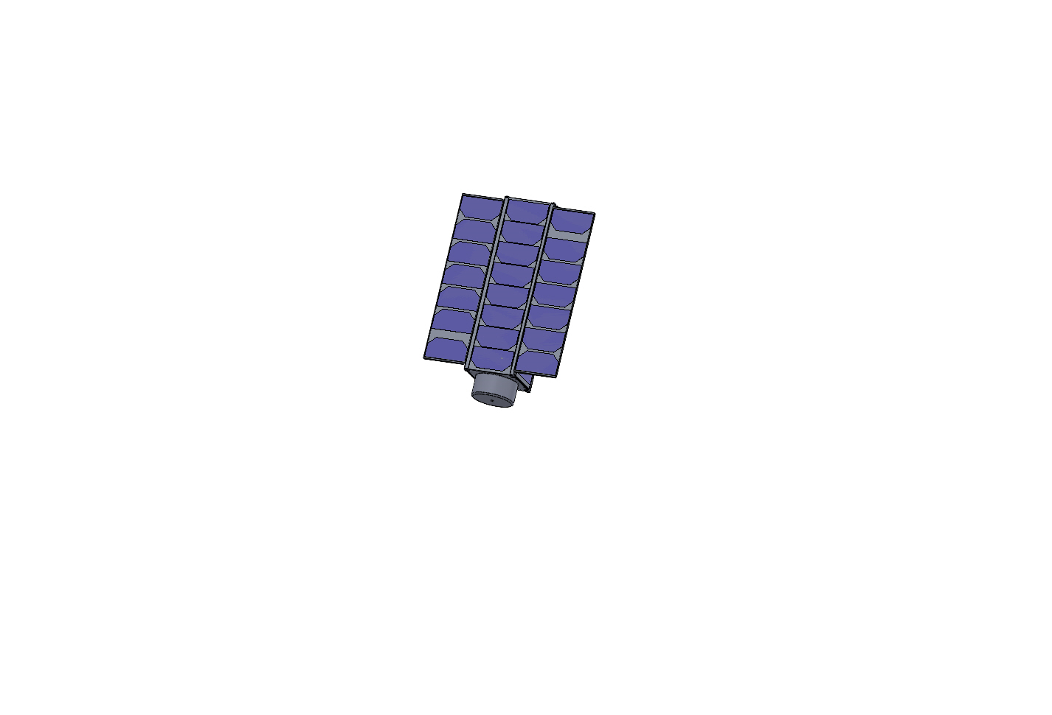
Future work
Optomechanical housing design
Optimization
Evaluate the performance
3D print
3U CubeSat design

